Slide 1
Graphic Rendering
Advanced higher GRAphic communication

Slide 2
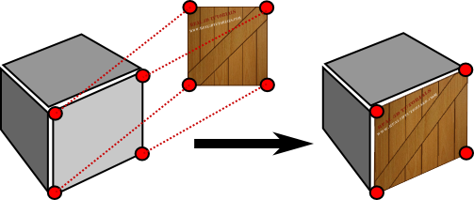
Graphic Rendering
Texture Mapping
This is a process whereby a texture is applied to the surface of a 3D CAD model to make it look like a material. The finished surface may look like timber, brick, etc.
In this example, the surface looks like wood, with a diagonal strap on it.

Slide 3
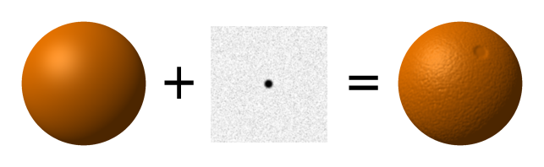
Graphic Rendering
Bump Mapping
This is a process which improves the visual appearance of the surface. Texture Mapping just makes a visual representation of the surface, whereas Bump Mapping adds an appearance of roughness or tactility to the surface.
The computer software knows how the material would look, and adds small shadows to help in its appearance.
NOTE – Bump mapping still keeps
the same Polygon count,
ie the surface is still perfectly flat.

Slide 4
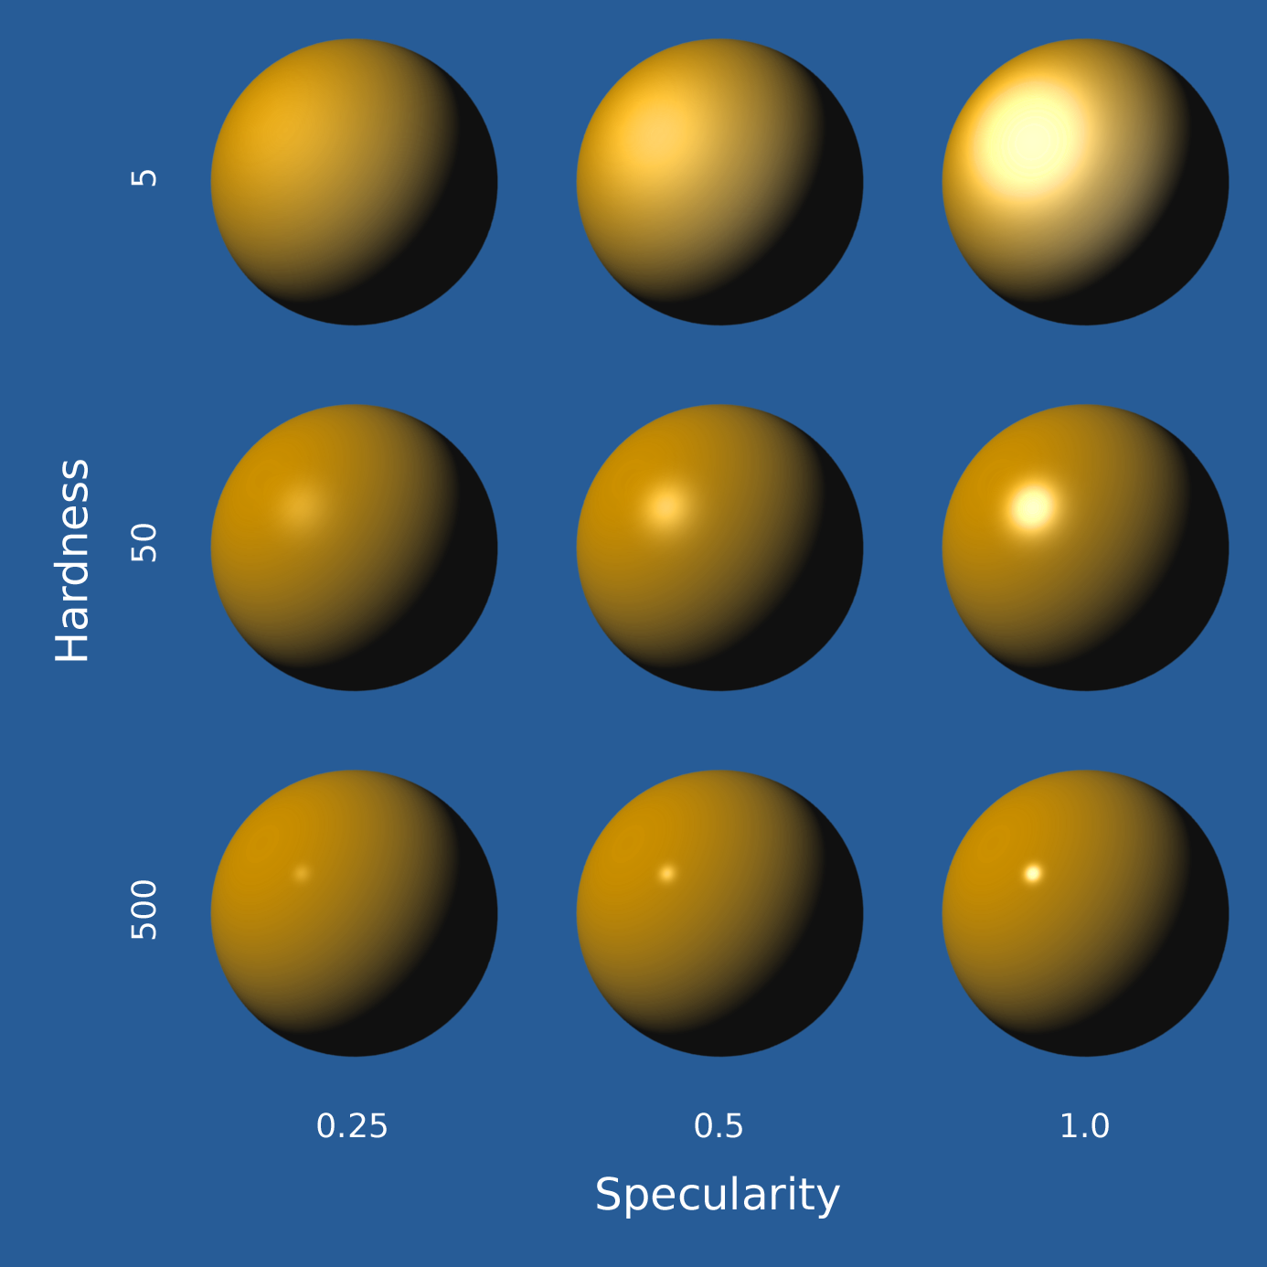
Graphic Rendering
Specularity
This describes the reflective capacity of a simulated material to create ‘rings’ of light reflection.
By determining the Specularity of a surface will affect how much light is reflected from a ‘material’.

Slide 5
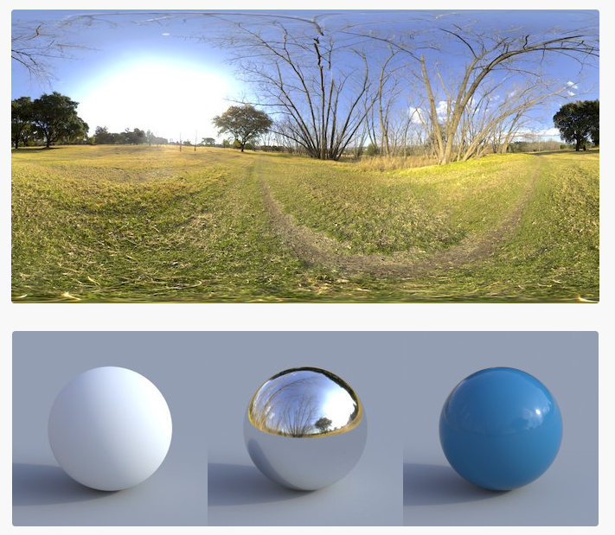
Graphic Rendering
Imaged Based Lighting (IBL)
This simulates how light and shadows from a real environment would affect the 3D CAD model. The image is taken by a special camera.
e.g. Placing a 3D CAD model in a streetscene would produce different results if it was in Irvine or Athens, if it was at night or during the day, if it was sunny or dull, if it was January or June.

Slide 6
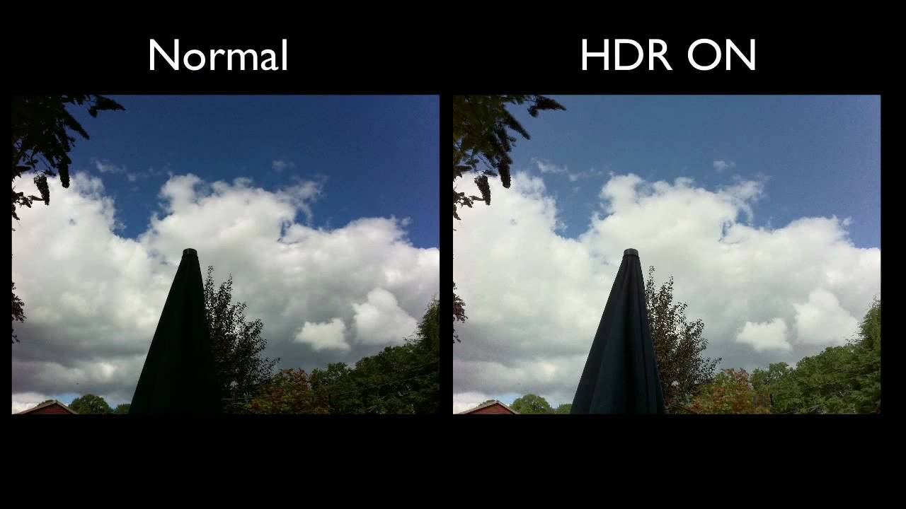
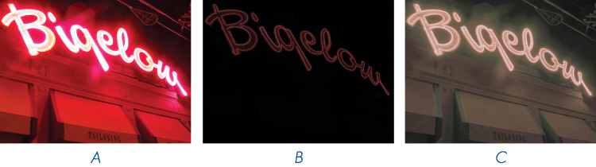
Graphic Rendering
High Dynamic Range Imagery (HDRI)
This is a process which takes multiple exposures (usually three) of an picture and then the software combines them to enhance the colour and shadow of the final picture. It is often used in Photography. The three
images would be a light,
medium and dark exposure.

Slide 7
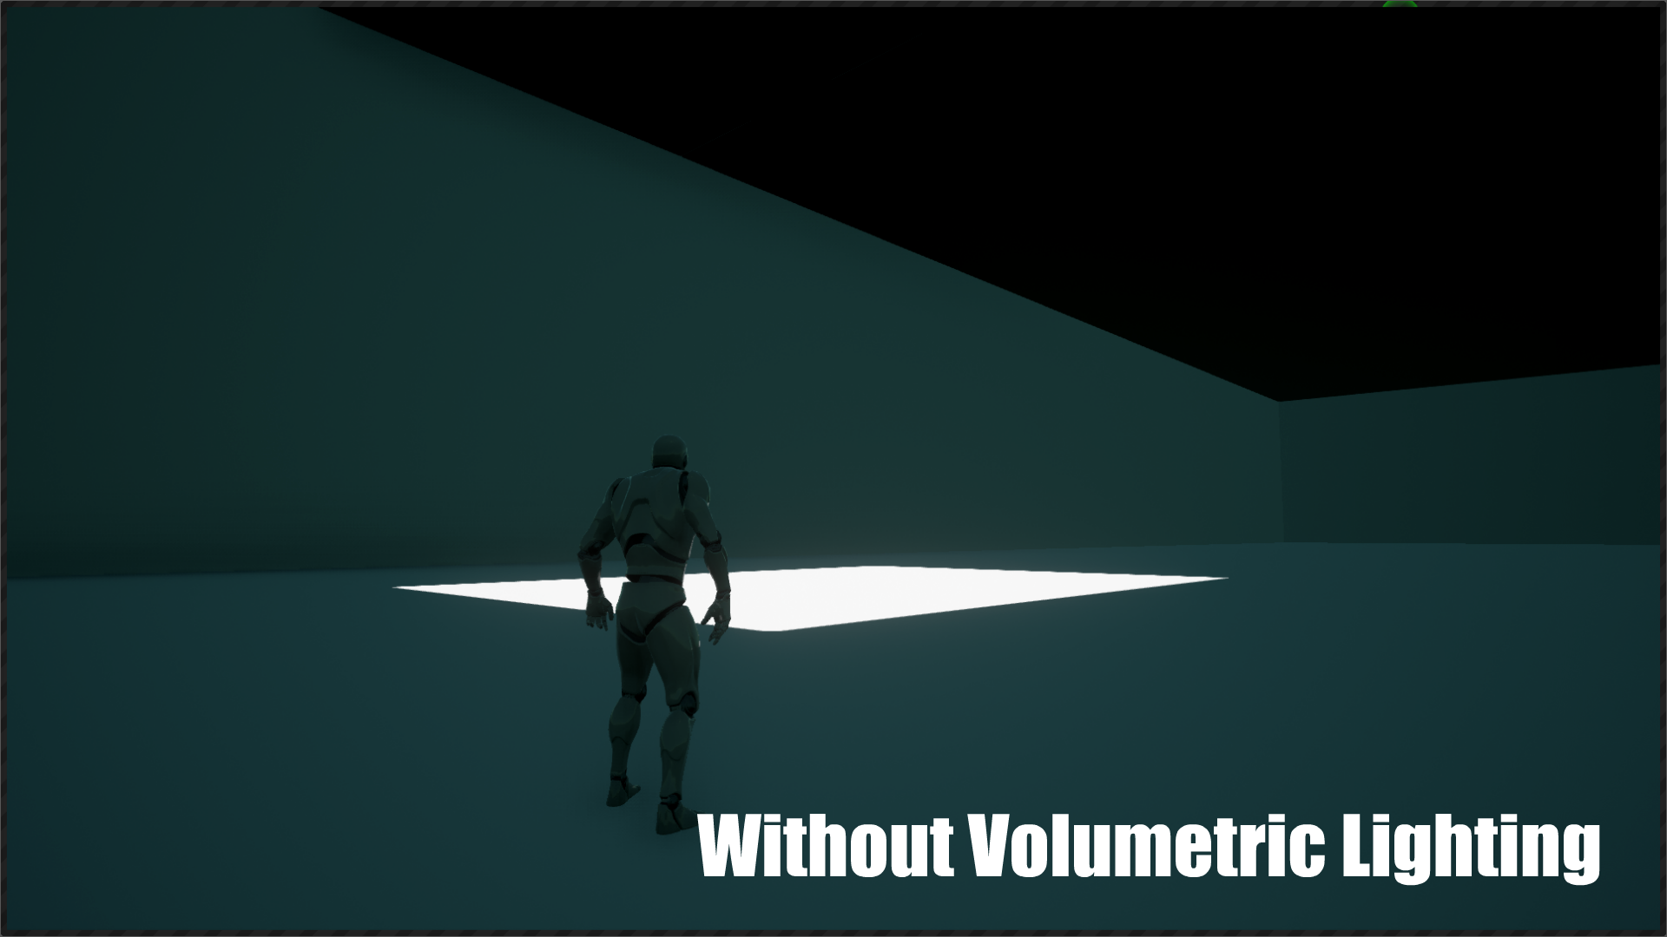
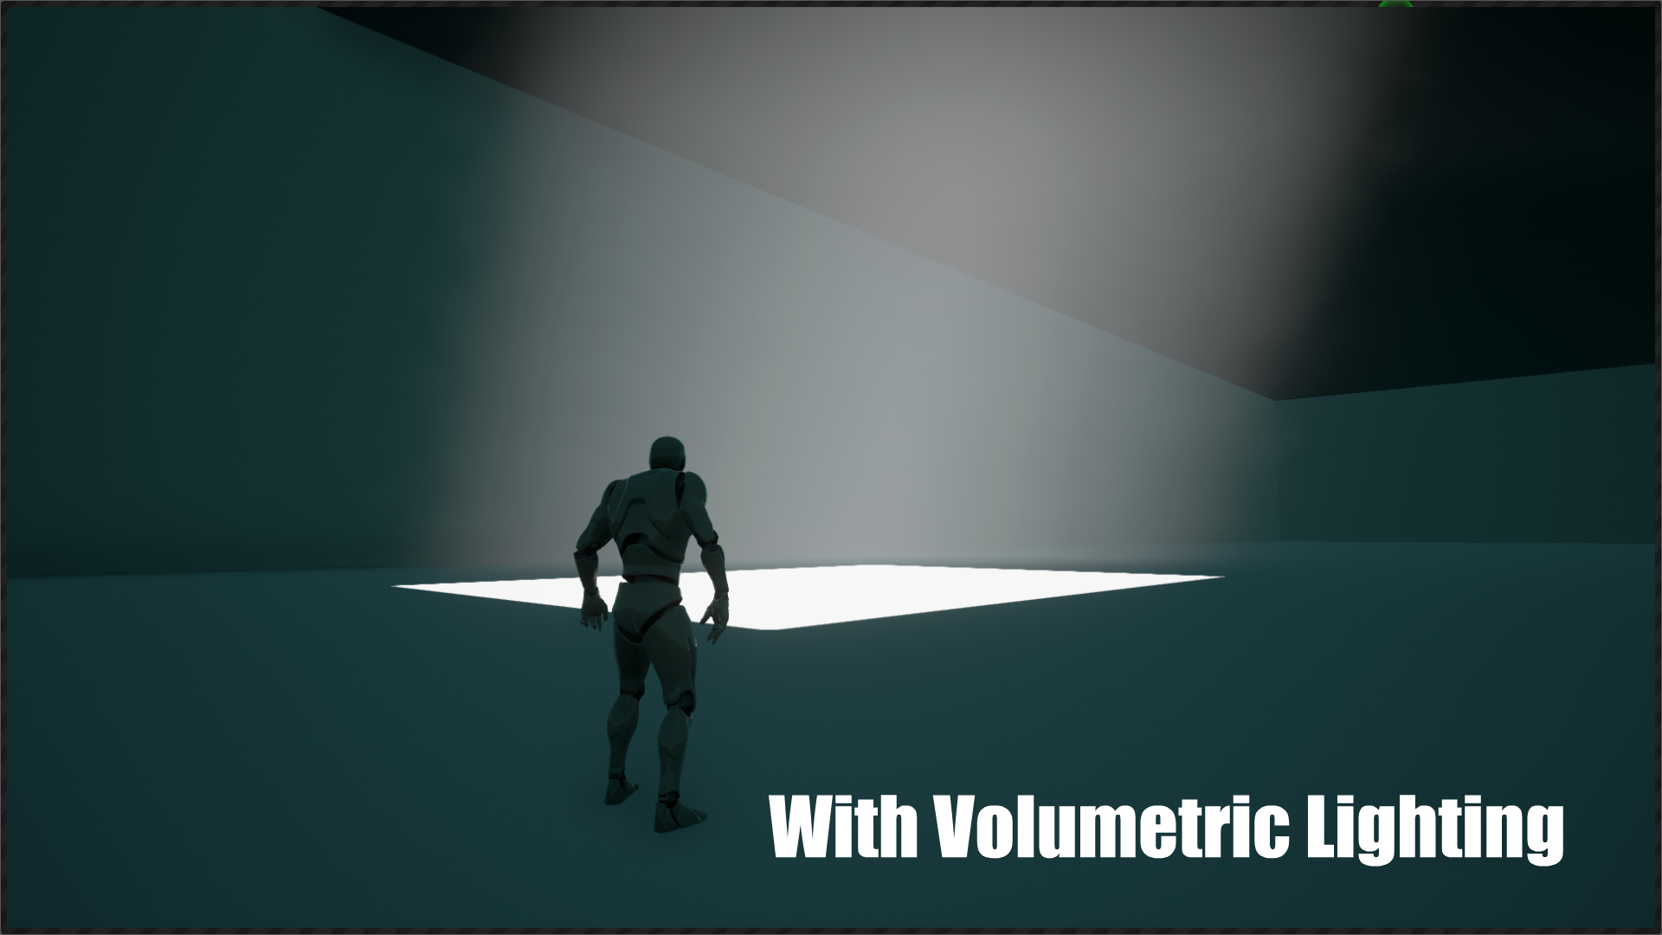
Graphic Rendering
Volumetrics
A method of giving a light source a sense of Volume or Substance. e.g. A light source may be a 40W bulb, 10W LED lamp, Fluorescent lamp, Halogen Lamp, etc.
The light can also be affected by passing through stained glass, obscure glass, smoke, etc.

