Slide 1
Graphic Communication
National 5 Revision

Slide 2

1. What are the three Primary Colours?

Slide 3
2. What are the three Secondary Colours?

Slide 4
3. Name 2 Advancing Colours

Slide 5
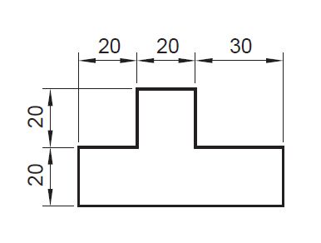
4. What sort of Dimensioning is used here?

Slide 6

5. What sort of Justification is used here?

Slide 7
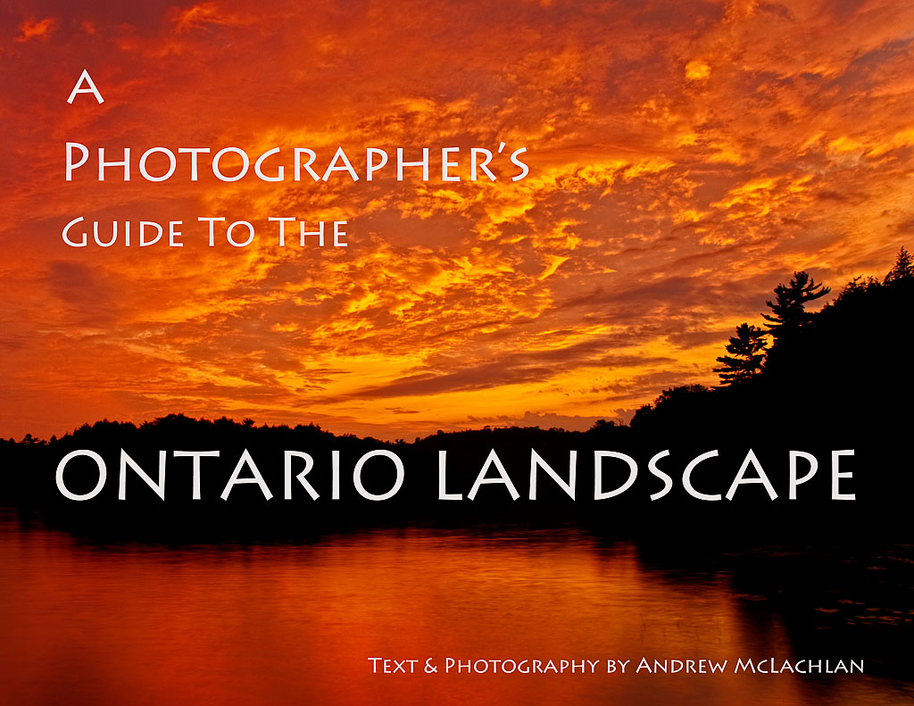
6. What term is used to describe the white lettering?

Slide 8
7. Where has Alignment been used in this image?

Slide 9
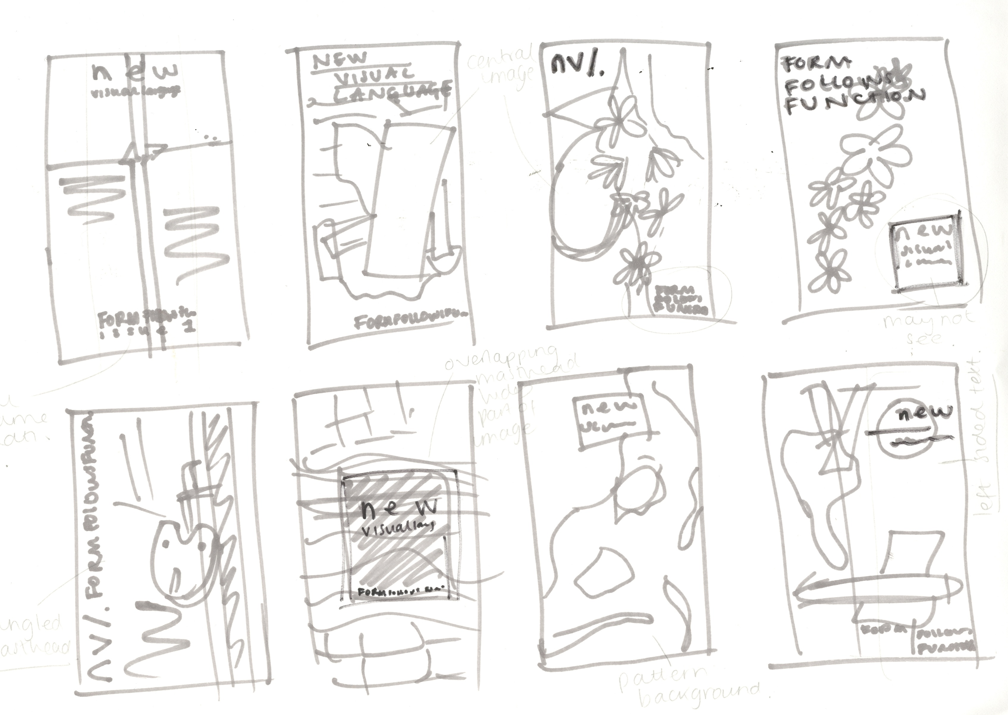
8. What is the name given to this type of sketch?

Slide 10

9. What does this symbol represent?

Slide 11
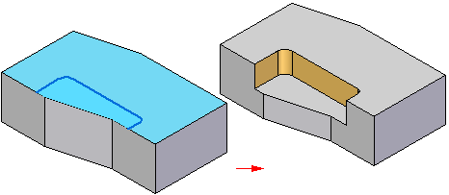
10. What 3D CAD feature is being demonstrated here?

Slide 12
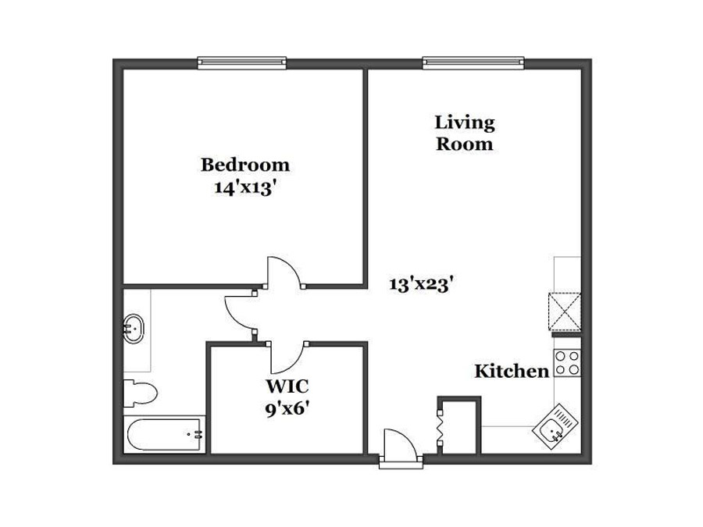
11. What is the name of this type of drawing?

Slide 13
12. What is the name of this symbol?

Slide 14
13. What is the name of this symbol?

Slide 15
14. What is the name of this symbol?

Slide 16
15. What is the name of this symbol?

Slide 17

16. The colours in this picture are a good example of what?

Slide 18

17. What does this symbol represent?

Slide 19

18. What does this symbol represent?

Slide 20
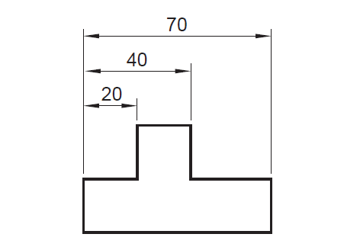
19. What type of dimensioning is used here?

Slide 21
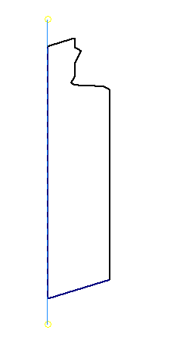
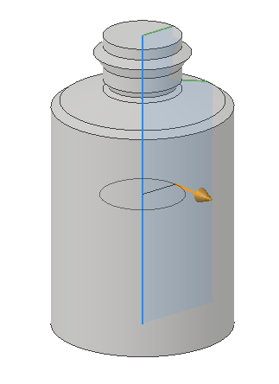
20. What 3D feature does the images represent?

Slide 22
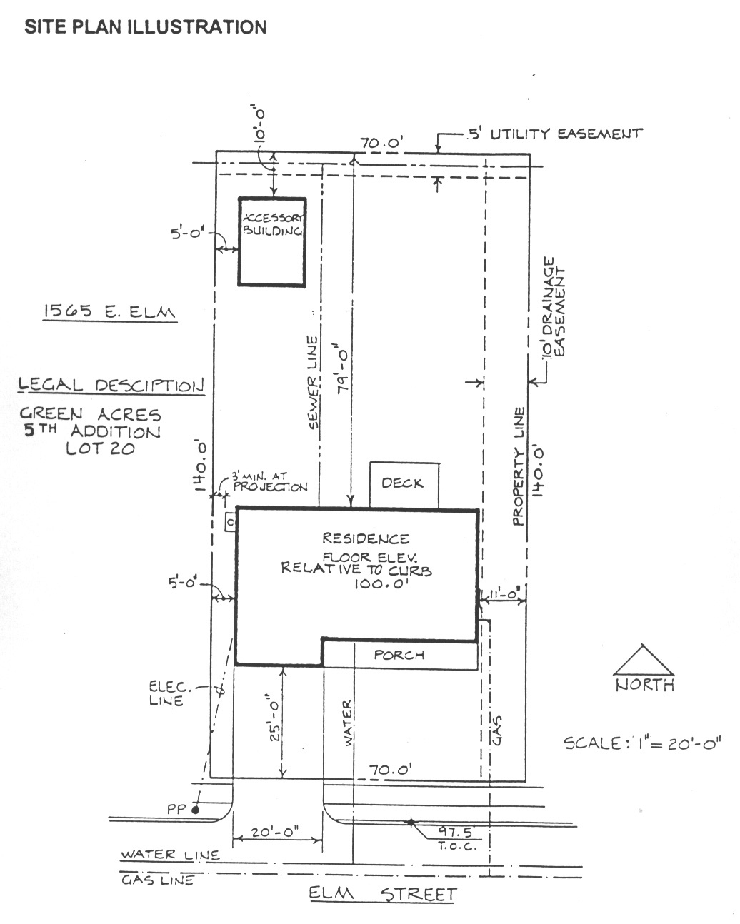
21. What is the name of this type of drawing?

Slide 23

22. What word describes the Layout used here?

Slide 24

23. What design principle is demonstrated here?

Slide 25

24. What symbol does this represent?

Slide 26
25. What symbol does this represent?

Slide 27

26. What symbol does this represent?

Slide 28
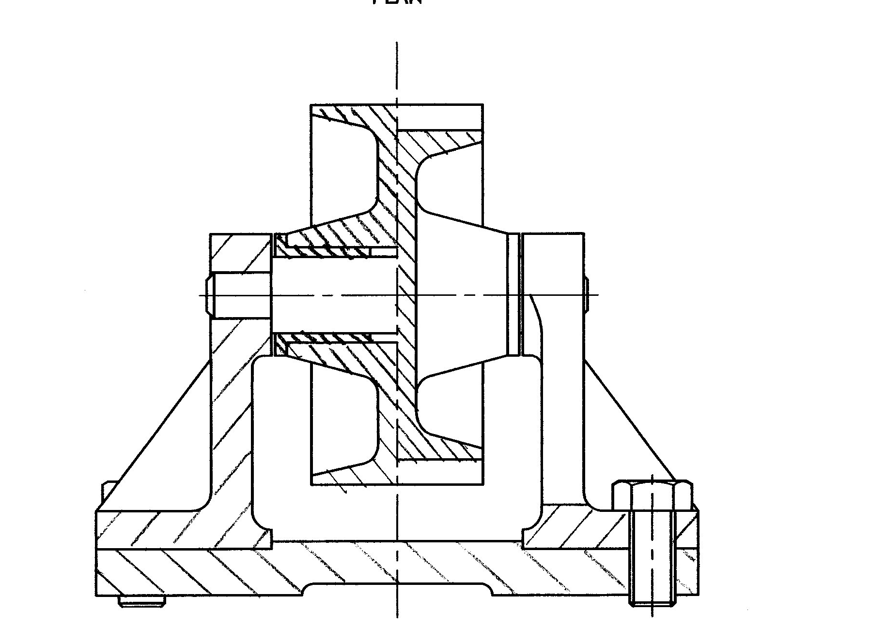
27. What is the name of this type of drawing?

Slide 29

28. What word describes the colours used in this logo?

Slide 30
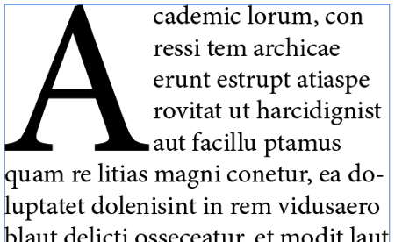
29. What is the name of the large A?

Slide 31
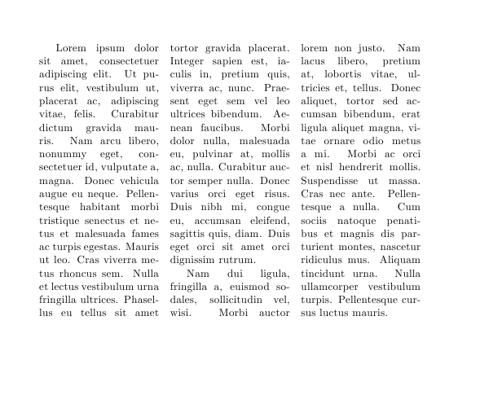
30. What is the name of the gap between the columns?

